Slide 1
Online Help Requirements Criteria and Examples
Prepared by
Nancy Zacks
Senior Information Architect
Dynamic Diagrams/Ingenta
8/30/01

Slide 2
Who will use the system?

Slide 3
In what environment will the help be used?

Slide 4
What will you use the help for?
Quick reference to procedures
Detailed conceptual information
System shortcuts
Learning workflow
Training? (“Quick starts” and tutorials)

Slide 5
What are some typical tasks in the system?

Slide 6
Basic Navigation Requirements
Table of contents
  Scope - collections, books
Index
  Indexing level - 1, 2, or 3 levels
Search
  keyword
  fulltext
  metadata

Slide 7
Basic Navigation Requirements (continued)
Search (cont.)
  ranked search results
  natural language features
Sequential
  sequences - previous/next
Different user paths and views
  e.g. author vs. manager
“See also” references

Slide 8
Content
DTD reference? (Available DTDs and allowed elements)
  Headings
  References
  Paragraphs
  Lists
  Figures
  Tables
  Equations

Slide 9
Content (continued)
  Video or animation
  FAQs

Slide 10
Other Features
Bookmarks
Printing
History/journal
Annotations
User-defined notes
“Wizards”
Redlining
Workflow aids

Slide 11
Display
Change font
Pop-ups for definitions
“What is” help
Separate window or embedded
Small or large window
Keep visible/hide
Tabs
Screen display requirements

Slide 12
Technology
Embedded help?
Context sensitive help?
Web delivery
  What technologies required to deliver desired functionality?
Print delivery required?
  PDF version needed?
Dynamic content?

Slide 13
Look and Feel
Logo or branding requirements
Language requirements
Display requirements
What do you like? What don’t you like when using a help system?

Slide 14
General Information Design Requirements
What kinds of chunks?
  Concepts?
  Procedures?
  Quick Reference?
  Pop-up help?
  Definitions?
  Process/work flows?
  Cross references?
  Information outside the system?

Slide 15
Help System Maintenance
How often will the system be revised?
Who will revise it?
Is there a procedure for revising?
Will online help be managed in the EDMS?

Slide 16
Other things to think about
Embed the help system in your application if possible. Work with developers to make a smooth connection between the system and its help.
Design the help system as a help application, not just an “online book.” Provide useful functionality, not electronic page-turning.

Slide 17
Examples of Online Help
Web Help
Windows Help
Custom HTML Help
  Sun Microsystems

Slide 18
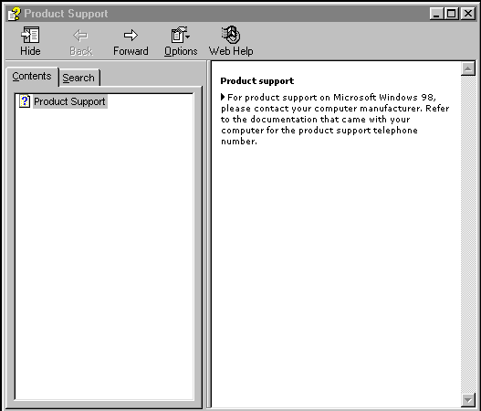
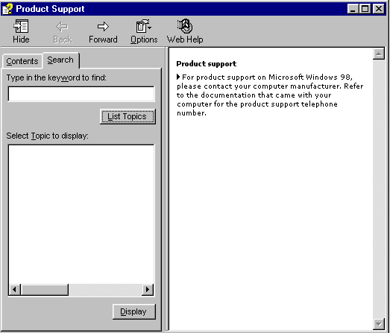
Web Help

Slide 19
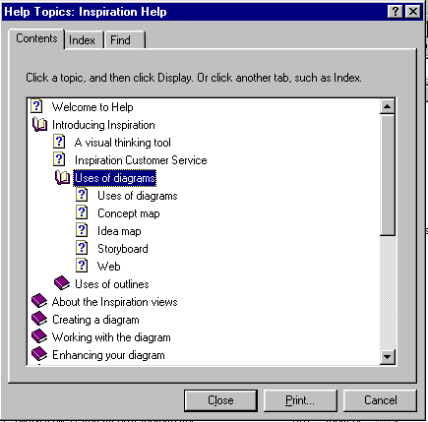
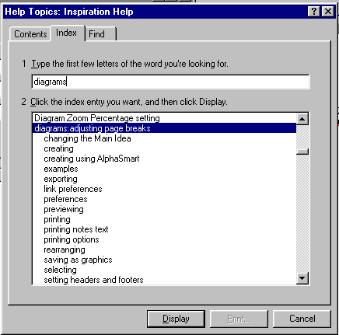
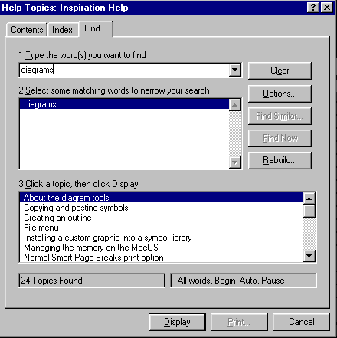
WinHelp

Slide 20
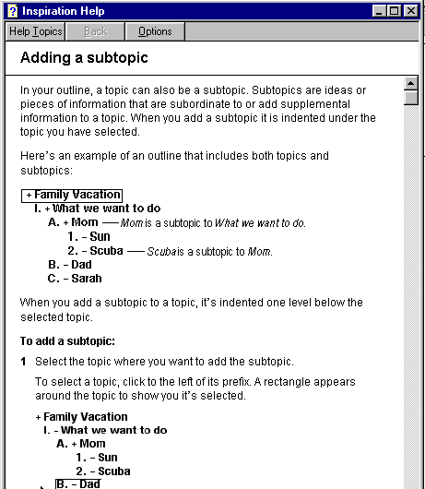
WinHelp Content Page

Slide 21
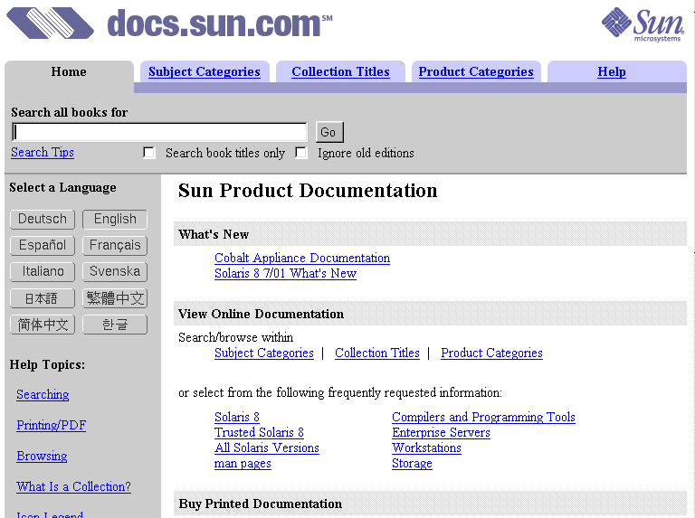
Custom HTML Help

Slide 22
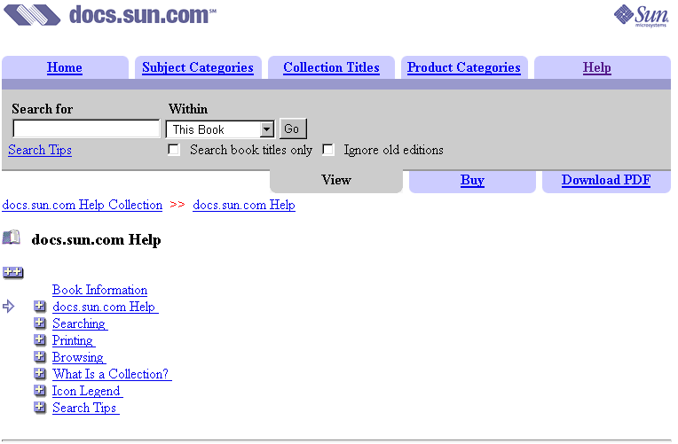
Custom HTML Help

Slide 23
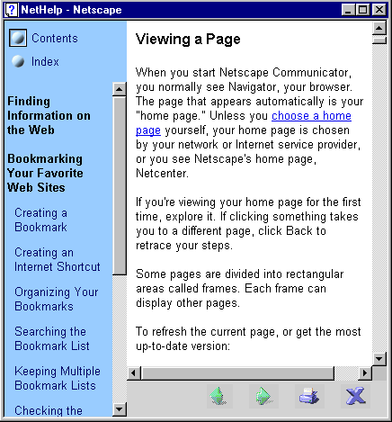
NetHelp TOC

Slide 24
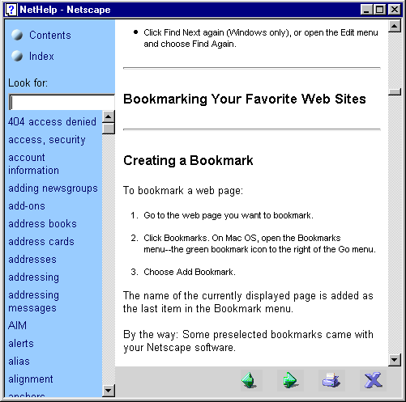
NetHelp Index

Slide 25
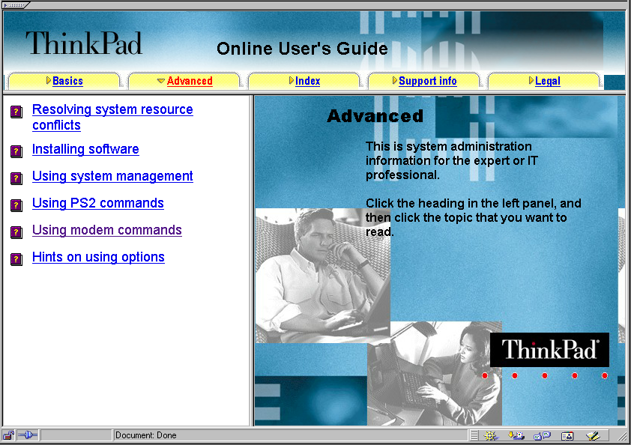
HTML Help

Slide 26
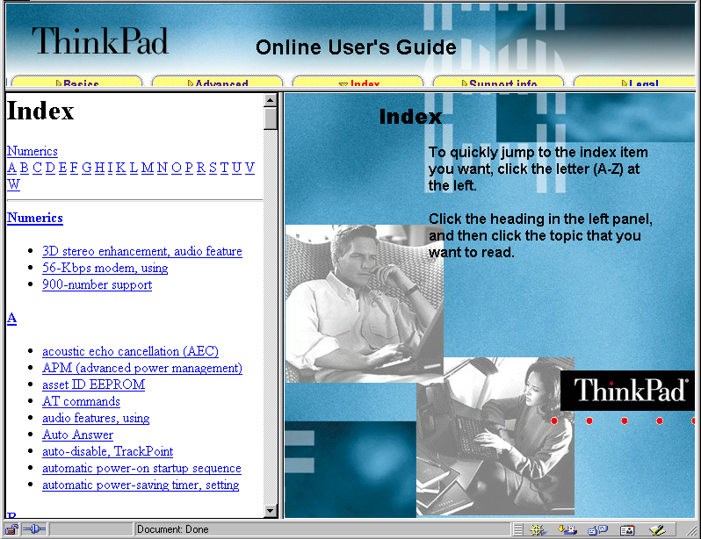
HTML Help Index

